Slide 1
Example Applications

Slide 2
Ten Simple Rules for charting
Know Your Audience
Identify Your Message
Adapt the Figure
Captions Are Not Optional
Do Not Trust the Defaults
Use Colour Effectively
Do Not Mislead the Reader
Avoid “Chartjunk”
Message Trumps Beauty
Get the Right Tool

Slide 3
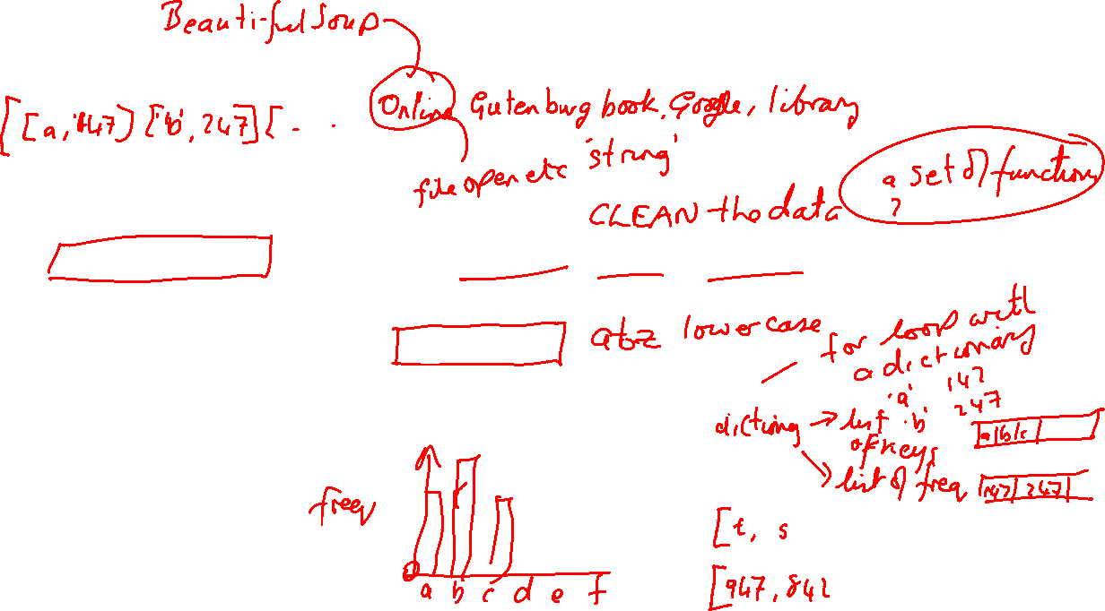
1 - Character Frequency Analysis of a text
Find a suitable source of text
Read the text into Python
Clean the data. Maybe it has headers, footers, page numbers, ISBN information, publication dates, etc,. Remove them.
Decide what counts as a character.
Count the number of occurrences of every character
Transform that information into a numpy array
Display using Matplotlib

Slide 4
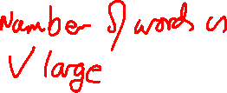
2 - Word Frequency Analysis of a text
Find a suitable source of text
Read the text into Python
Clean the data. Maybe it has headers, footers, page numbers, ISBN information, publication dates, etc,. Remove them.
Decide what counts as a word.
Count the number of occurrences of every word
Transform that information into a numpy array
Display using Matplotlib ???

Slide 5
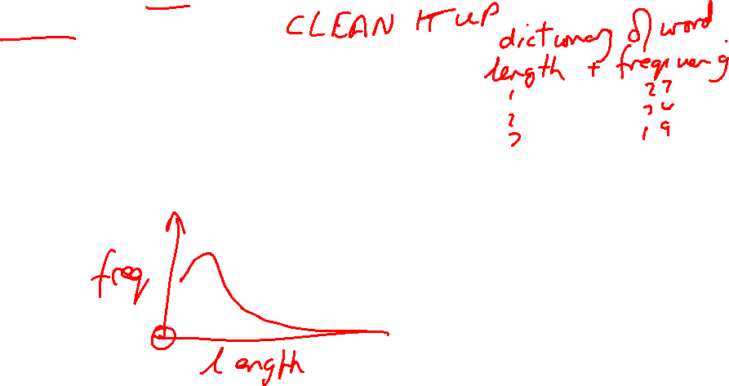
3 - Word Frequency-Length Analysis
Find a suitable source of text, read it into Python and clean it up
Decide what counts as a word.
Count the number of occurrences of every word
Measure the length of every word
Transform that information into a numpy array suitable for charting
Display using Matplotlib

